Slide 1


IPCEI for the PV manufacturing in Europe
Project group for Circular PV – targets and cases
January 2022

Slide 2

Background
Ambitious European plans for PV power generation towards 2030 and 2050
Continued innovation in PV technology along the value chain over many years
  Several recent European and national projects looking at recycling, reuse, low environmental footprint PV
    CABRISS (H2020)
    ECO-SOLAR (H2020)
    Super PV (H2020)
    CIRCUSOL (H2020)
    HIGHLITE (H2020)
    ICARUS (H2020)
    PHOTORAMA (H2020)
    ...
Need for European PV supply, and supply chain, robustness to reach targets for low footprint power generation
Need competitive European PV supply, and supply chain
Several implemented and planned EU policies will affect (and motivate) European PV industry along the whole value chain

Slide 3
Policy factors
EU Taxonomy
EcoDesign & Energy Labelling
Recent push for European energy independence in light of the war in Ukraine
Recent initiative on EU Solar Strategy
Carbon Border Adjustment Mechanism (CBAM) (expected only long term effects)
+ others…
These will influence the production and use of PV in Europe with or without the IPCEI
The IPCEI for PV can contribute to a better leverage for shaping these policies

Slide 4
Principles for IPCEI PG Circular PV contribution
Not to drive policy formation, but be aware of possible influence on value chain
Leverage previous and ongoing knowledge and results on technology and business innovation
Align and scale current plans to IPCEI PV/ESMC/ESI ambitions (20 GW/100 GW)
Suggested scope of IPCEI PV activities:
  Technical development (new module types, materials, recycling and production processes…)
  Support activity giving relevant insights for standards and policy development
  Business model development (what type of organizations needed, what is the hand-off between actors in the new circular value chain, who does what and how do they make sufficient money doing it)
  Information system innovation (how can ICT help enable goals – e.g. material passport)
  Information to stakeholders (find out how to consistently measure progress on goals, suggest measurement and book-keeping methodology to support policy)

Slide 5
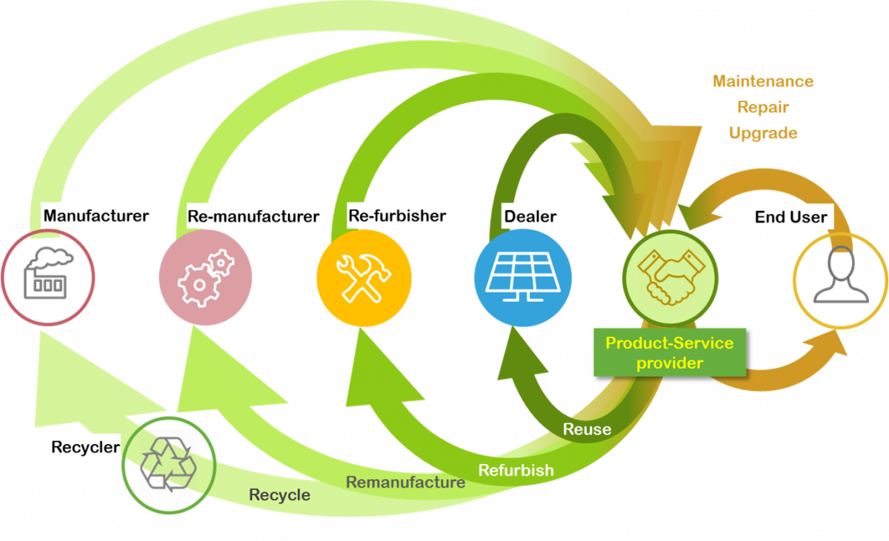
Vision
Heavily influenced by previous work by others…
To be defined
H2020 project CIRCUSOL webpage: https://www.circusol.eu/en/overview/what-to-expect

Slide 6
Market failures
Energy security
  Europe dependent on foreign gass&oil
  Increasing momentum for electrification and buidling of renewable energy infrastructure
Failure:
  Dependence on energy imports makes Europe vulnarable
  More energy could be produced by European infrastructure and European components
IPCEI PV solves this by:
  European value chain for energy components
  Support for increased European energy production without fuel imports

Slide 7
Market failures
Module production in Europe today imports most of the needed material
  Most cells and other materials, mainly from China
Failure:
  Little established European material streams for high purity, high value materials for PV modules makes European manufacturing vulnerable to supply chain disruption
  By using components produced outside Europe, predominantly China, the CO₂ footprint of the components are much higher than they could be
IPCEI PV solves this by:
  Encouraging European manufacturing along the whole value chain
  Focus on best-in-class innovation and low CO₂ materials and technology

Slide 8
Market failures
WEEE mandates 75 % recycling of volume of PV modules
  This is covered by recycling Cu-wires, Al frame and glass
  Al easy to keep quality, glass is typically down-cycled
  Remaining volume landfilled
Failure:
  High purity material, high value (low volume) material wasted (environmental impact)
  High value material wasted (“critical materials” security for Europe)
  Not 100 % recycling
  Waste volumes will become very large: proper handling necessary both from environmental and reputational perspectives
Fix:
  Should be a material quota

Slide 9
Market failures
Low CO₂ PV not valued Europe wide
  ..
Failure:
  ..

Slide 10
Market failures
Modules not desgined for recycling or repair
  Modules made as low cost and long duration as possible
Failure:
  Low expectations/demands for recycling
  Little incentive to design for easy dismantling/material separation
  Little incentive to develop methods for repair
  Environmental footprint of PV-generated kWh worse than potential

Slide 11
Market failures
A significant fraction of discarded PV modules are functional
  Increasing volumes in the future
  Economic lifetime of PV parks can be down to 10-15 years or less while modules last longer
Failure:
  Sub-optimal market for reuse, allready signs of negative reputation effects
  Standards and business models for ensuring market access and market acceptance lacking
  Environmental footprint of PV-generated kWh worse than potential

Slide 12
Goals/targets per segment
Recyclers
  LuxChemtech, REC Solar Norway (recycling silicon), ROSi, (Veolia?), Fraunhofer CSP, ISC Konstanz, Eurac Research, SINTEF, IFE, ENEA, IPVF, INES
Module manufacturers (but part of other working groups? Do we have the funding gap in Circular PV or other groups?)
  MCPV, Solarge, SolarWatt, SoliTek, Voltec Solar, FuturaSun, ENEL Green Power, 3S Solar Plus, Fraunhofer CSP, ISC Konstanz, Eurac Research, SINTEF, IFE, ENEA, IPVF, INES
Reuse/repair value chain
  FuturaSun, Solitek, ENEL Green Power, Fraunhofer CSP, ISC Konstanz, Eurac Research, SINTEF, IFE, ENEA, IPVF, INES
Material and component producers
  Coveme, REC Solar Norway, Norsun, AGC, Standex, Valoe (Cells), Applied Materials, Fraunhofer CSP, ISC Konstanz, Eurac Research, SINTEF, IFE, ENEA, IPVF, INES

Slide 13
Suggestion for goals/targets per segment (2030)
Recyclers
  Enable business models
  Perform technology development and scaling for efficient module recycling
  Handling approx. 180 kTons + of waste pr year
  Increase from 75 % to 98 % recycling of weight/volume of annual waste
  Increase recycling rates for all materials:
    Silicon:
      Manufacturing waste recycling: from a few % of recycled kerf today towards >90 %, recycling of side- and top cuts and similar waste is kept at near 100 %
      EoL recycling: from near 0 % today to >90 % for all purposes (open loop), increasing use of recycled EoL silicon in PV silicon production towards 10 % of EoL silicon
    Glass from high recycling rate today, open loop/low value (shredding which gives contaminated material - downcycling) to near 100 %, but increasingly higher value: >50% high value products through high quality cullet, also, depending on the introduction of a material passport start closed loop recycling of PV glass
    Metals from cell and interconnect (Ag, Cu, Al, Pb, In/Sn (ITO), Bi) from 0 – 100 % (open loop)
    Polymer backsheet from some thermal recycling to 100 % PET recycling, open loop, 20 % other recycling (fluorine containing), open loop
    Encapsulant from some thermal recycling to developing scalable process for material recycling
    Junction box already has high recycling rate (as normal electronic waste)
    Al-frames already has high recycling rate (open loop)
    Cu from wires already has high recycling rate (open loop)

Slide 14
Suggestion for goals/targets per segment (2030)
Part of other working groups? Do we include the funding gap in Circular PV or another group?
Module manufacturers
  Lower CO₂ footprint* (+ other environmental metrics)
    European average of 400 kgCO₂eq/kWp by 2025 and 300 kgCO₂eq/kWp by 2030. Additional reduction can be expected if large scale implementation of low CO₂ Si and other innovations are conducted
      Using innovative design, high efficiency concepts
      Using less material (reduction in kg/Wp)
      Using low CO₂ components and materials
      Using recycled materials
      3rd party certified documentation of environmental footprint
  Support policy for design for recycling and repair/Eco Design
  Develop supporting knowledge, methods, standards to enable long lifetime modules (product warrantable to 40 years)
  Introduce material passport/accessible BOM for
  each module
Chinese 700-800 kgCO2-eq/kWp
SunPower Maxeon module with Norsun wafers shown in 2021 EPD: 342 kgCO2eq/kWp
*Calculated using the French tendering system (more detail needed)

Slide 15
Suggestion for goals/targets per segment (2030)
Component producers
  Overall goal: motivate and support establishment of participants in all parts of the value chain
  Silicon: 90+ % reduction in CO2 emissions from Si feedstock used compared to all Chinese imports. Go from 244 000 Tonns CO₂-eq to 16 230 Tonns CO₂-eq at 100 GW annual production rate with lowest CO₂ wafers
  European, low CO2 production of:
    Back sheet
    Encapsulant
    Glass
    Wires
    Al
    …
  Enable digital services connected to low CO2, circular value chain

Slide 16
Suggestion for goals/targets per segment (2030)
Reuse/repair value chain
  To establish a second hand market – perhaps not the job of IPCEI as it is a very policy driven activity?
  Support policy with technical standards, experience through pilots
  Possible goal: 50 % of all functioning modules decommissioned are reused

Slide 17
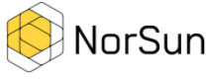
Cases
Norsun
  Contribution to IPCEI:
    Low CO₂, high quality Cz-Si wafers
    Enabling European value chain
    Enabling circular value chain
  Plans:
    Public plans for expansion towards 5 GW total capacity
    Potential for including low CO2 feedstock (REC Solar E2M)(35,4 kgCO₂-eq/m² wafer -> 11,5 kgCO₂-eq/m² wafer)
  Gaps covered by IPCEI:
    Substantial investment needed
    Innovation on energy efficiency increases, automation, worker and environment safety, new feedstock (with roadmap)
  Potential effect:
    …

Slide 18

Cases
REC Solar Norway
  Contribution to IPCEI:
    Low CO₂, high quality Si feedstock
    Enabling European value chain
    Enabling circular value chain
  Plans:
    No commitments on expansion
    Potential for increasing production of kerf recycled Si feedstock
    Development of process for recycling EoL silicon (high quality Si to high quality Si)
  Gaps covered by IPCEI:
    Unknown, uncertain investment
    Innovation on process for further refining kerf recycled Si feedstock (E2M: 6-7 kgCO₂-eq/kg E2M compared to 140 kgCO₂-eq/kg Chinese poly-Si)
    Innovation on process for using recycled EoL silicon in PV feedstock
  Potential effect:
    …

Slide 19

Cases
Coveme
  Contribution to IPCEI:
    High quality module backsheet, Fluorine free
    Enabling European value chain
    (Enabling circular value chain)
  Plans:
    Expansion of production in Italy seems flexible when market conditions support it
    Increase sustainability by using recycled PET (non-PV origin)
    Have successfully tested recycled PET from PV, however, need volume and separation process
  Gaps covered by IPCEI:
    Unknown investment
    Innovation on process for further increasing recycled PET in product
    Innovation on process for using recycled PV PET

Slide 20

Cases
LuxChemtech
  Contribution to IPCEI:
    Recycling process for modules – separation into various material streams
    Enabling circular value chain
    Enabling European value chain
  Plans:
    Build first full industrial scale recycling plant when market conditions support it (operating the whole year)
    Develop and build automated machinery together with equipment suppliers
  Gaps covered by IPCEI:
    Investment in the order of x mill.EUR for first plant. Easily duplicated and scaled
    Innovation and implementation on recycling process for extracting high value metals
    Innovation on treatment of glass to increase recycled value
    Innovation on treatment on silicon to increase recycled value

Slide 21
Cases
SoliTek
Voltec Solar
Solarge

Slide 22
Cases
FuturaSun

Slide 23
Comments on cases
Opportunities available, but unsure how they fit into IPCEI PV:
  Huge investment needs for expanding glass production in Europe + investment and innovation need for greening glass production (e.g. hydrogen, waste heat, recycled glass cullets, local production)
  Several module manufacturers planning and undergoing expansion, but not clear how IPCEI will contribute: e.g. Meyer Burger (7 GW (2027)), ENEL Green Energy (3 GW (2024)), possibly REC Solar France (4 GW (?))
    All have ambitions for innovations related to increased sustainability of modules
    Huge investments – should be accounted for in argumentation towards EC!
  Currently no (?) manufacturer in Europe is counting on a 20/100 GW European manufacturing base. If/when they do plans for expansion will look different – how to handle this?

Slide 24
THANK YOU FOR YOUR ATTENTION!

